Slide 1

MTECH AAI COHORT-1 Dissertation Project – Phase 1
Presented by: Sanjeev Kumar Pandey
Enrolment No: MT23AAI001
Project Guide: Dr. Amit Agrawal

Slide 2

AI/Data-Driven Positioning and Human Activity Recognition
VNIT Nagpur
Sanjeev Kumar Pandey

Slide 3
Introduction
Human Activity Recognition (HAR) aims to automatically identify and classify human actions using sensor data.
Traditional HAR approaches rely on cameras or wearable sensors, which can raise privacy concerns, require user compliance, and may be affected by lighting or obstructions.
Recent advances leverage Wi-Fi Channel State Information (CSI), which captures fine-grained changes in wireless signals caused by human movement, enabling device-free, non-intrusive activity recognition.

Slide 4
Motivation
Privacy & Comfort: CSI-based HAR does not require cameras or wearables, preserving user privacy and comfort in sensitive environments like homes and healthcare facilities.
Ubiquity & Cost-Effectiveness: Utilizes existing Wi-Fi infrastructure, making deployment practical and affordable
Robustness: CSI provides detailed amplitude and phase information, allowing accurate detection of subtle and complex activities even through walls or in low-light conditions.
Research & Real-World Impact: Enables applications such as elderly monitoring, fall detection, smart homes, and security, driving significant interest from both academia and industry.
Technological Advancement: The integration of deep learning with CSI data has demonstrated high accuracy and reliability, opening new frontiers in non-intrusive human sensing

Slide 5

Problem statement
02
Unlocking new horizons

Slide 6
Problem statement
Traditional Human Activity Recognition (HAR) systems often rely on cameras or wearable sensors, which:
  Compromise user privacy
  Require user compliance and maintenance
  Are sensitive to lighting conditions and obstructions
There is a need for a non-intrusive, privacy-preserving, and robust HAR solution that can:
  Accurately detect and classify multiple human activities in real-time
  Work effectively in diverse indoor environments without requiring users to wear devices or be constantly monitored by cameras
Key Challenge: How can we leverage Wi-Fi Channel State Information (CSI) data to develop an accurate and reliable HAR system that overcomes the limitations of traditional approaches?

Slide 7
Objectives
Develop a HAR system using Wi-Fi CSI data
Accurately classify 10 human activities
Ensure privacy without cameras or wearables
Evaluate performance in real indoor environments
Goal: Deliver a robust, privacy-preserving HAR solution for practical applications.

Slide 8

Literature Review
03
Shortlisting best approach

Slide 9
Research Paper Reference
Wang et al. (2017), "Device-Free Human Activity Recognition Using CSI," IEEE TMC.
  Source: https://dl.acm.org/doi/10.1109/jsac.2017.2679658
Kotaru et al. (2015), "SpotFi: Decimeter Level Localization Using WiFi," ACM SIGCOMM.
  Source: https://web.stanford.edu/~skatti/pubs/sigcomm15-spotfi.pdf
Yongsen Ma, Gang Zhou, Shuangquan Wang (2019), "WiFi Sensing with Channel State Information: A Survey" IEEE IoT Journal
  https://dlnext.acm.org/doi/abs/10.1145/3310194
Zhenyue Gao, Jianqiang Xue, Jianxing Zhang & Wendong Xiao (2022)" Cross-modal meta-learning for WiFi-based human activity recognition," ACM Digital Library
  https://dl.acm.org/doi/10.1145/3570361.3615754

Slide 10
Dataset / Research Paper Mapping
CSI Based Datasets
  Kaggle CSI Dataset (geninhu/csi-dataset) : https://www.kaggle.com/datasets/geninhu/csi-dataset
  UT-HAR : https://github.com/xyanchen/WiFi-CSI-Sensing-Benchmark
  Widrar3.0 : https://tns.thss.tsinghua.edu.cn/widar3.0/ https://cswu.me/papers/mobisys19_widar3_paper.pdf
  CSI Dataset for Wireless Human Sensing : https://ieee-dataport.org/documents/csi-dataset-wireless-human-sensing-80-mhz-wi-fi-channels
Sensor Based Datasets
  UCI HAR : https://archive.ics.uci.edu/ml/datasets/human+activity+recognition+using+smartphones
  KU-HAR : https://paperswithcode.com/dataset/ku-har
Human Activity Recognition based on Wi-Fi CSI Data : https://eprints.whiterose.ac.uk/id/eprint/184207/1/1-s2.0-S1877050921024509-main.pdf

Slide 11
Datasets
CSI Based Dataset
Dataset Name | Description
Kaggle CSI Dataset (geninhu/csi-dataset) | Wi-Fi Channel State Information (CSI) data for HAR. Contains raw CSI measurements suitable for activity recognition and wireless sensing research. 10 distinct human activities by 30 Participants
UT-HAR | Wi-Fi CSI data, 6 activities, 30 participants, 2.4/5 GHz bands.
Widar3.0 | CSI for 25 activities, 3D motion tracking.
CSI Dataset for Wireless Human Sensing | 7 activities, 10 people, 7 environments, 80 MHz Wi-Fi, 13+ hours of CSI data
Sensor Based Dataset
Dataset Name | Description
UCI HAR | Smartphone accelerometer/gyroscope, 6 activities.
KU-HAR | 18 activities, 90 participants, wearable sensors.

Slide 12
CSI Based Dataset
This dataset is providing rich, fine-grained wireless signal data, making it ideal for developing robust and accurate HAR models, especially in indoor environments where privacy and unobtrusiveness are important.
Source URL | https://www.kaggle.com/datasets/geninhu/csi-dataset
Type | Wi-Fi Channel State Information (CSI) data for Human Activity Recognition (HAR)
Number of Activity Classes | 10 distinct human activities [ 'falling_down_from_sitting_position' 'falling_down_from_standing_position' 'lying' 'pick_a_pen_from_the_ground' 'sitting' 'sitting_down' 'stand_still' 'standing up' 'turning' 'walking’ ]
Data Format | Training and evaluating machine learning models for activity recognition and wireless sensing research
Data Size | 1 directory, 30 files (as per Kaggle listing)
Applications | Non-intrusive, privacy-preserving activity recognition

Slide 13

Proposed Methodology
04
Executive Team and Key Departments

Slide 14
Data Acquisition & Preprocessing
  Collect raw Wi-Fi CSI data for 10 activities.
  Denoise and normalize signals; apply Mixup augmentation.
Hybrid Deep Learning Model
  ResNet-1D for spatial feature extraction.
  BiLSTM for temporal sequence modelling.
  Attention layer to focus on key time steps.
Hybrid feature extraction strategy:
  Signal preprocessing (filtering, PCA) to enhance raw CSI data.
  ResNet-1D for spatial/local feature learning.
  BiLSTM + Attention for temporal modeling and focus.
  Mixup for robustness against overfitting.
Training & Validation
  5-fold cross-validation for robustness.
  AdamW optimiser, cosine learning rate decay, dropout regularisation.
Evaluation
  Assess with accuracy, F1-score, and confusion matrix.
  Visualise results and class distributions.

Slide 15
Novelty and Innovation
Hybrid Model: Combines ResNet-1D, BiLSTM, and Attention for robust spatial-temporal feature extraction from CSI data.
Device-Free & Privacy-Preserving: Uses Wi-Fi signals-no cameras or wearables required.
Advanced Augmentation: Mixup technique improves generalization and performance.
Real-World Evaluation: Validated on diverse, unconstrained indoor activity data.
Delivers accurate, privacy-focused HAR using cutting-edge deep learning and wireless sensing.

Slide 16
System Architecture Diagram
Model Training and Validation
Pre-processing
Training with K-Fold Validation
Data Loading
Model Creation
Evaluation
Visualization (Plots)
End

Slide 17
Data Loading
Load NPZ Files
Concatenate Subjects
End
Pre-processing
Stratified Train / Val / Test Split
Label Encoding
Reshape Data
End
Model Architecture
ResNet-1D Block
Bidirectional LSTM
Attention Mechanism
Global Pooling
Dense Classification
End

Slide 18
Training with K-Fold Validation
Training
K-Fold Cross Validation
Mixup Augmentation
Cosine LR Scheduling
Save Best Model
Checkpointing
End
Evaluation
Test Set Metrics
Confusion Metrics
Class Distribution
End
Visualization
Accuracy/Loss Curves
Feature Analysis
Model Weights
End

Slide 19
Real Time Inference
Load Config
Find Best Model
Load Best Model
Load Test / Real Data
Process Each Sample
Pre-process Sample
Pre-process Sample
Predict Activity
Display Result (True vs Predicted)
Check correctness and Delay
Compute Final Accuracy
End Inference

Slide 20
Implementation Plan and Timeline
04

Slide 21
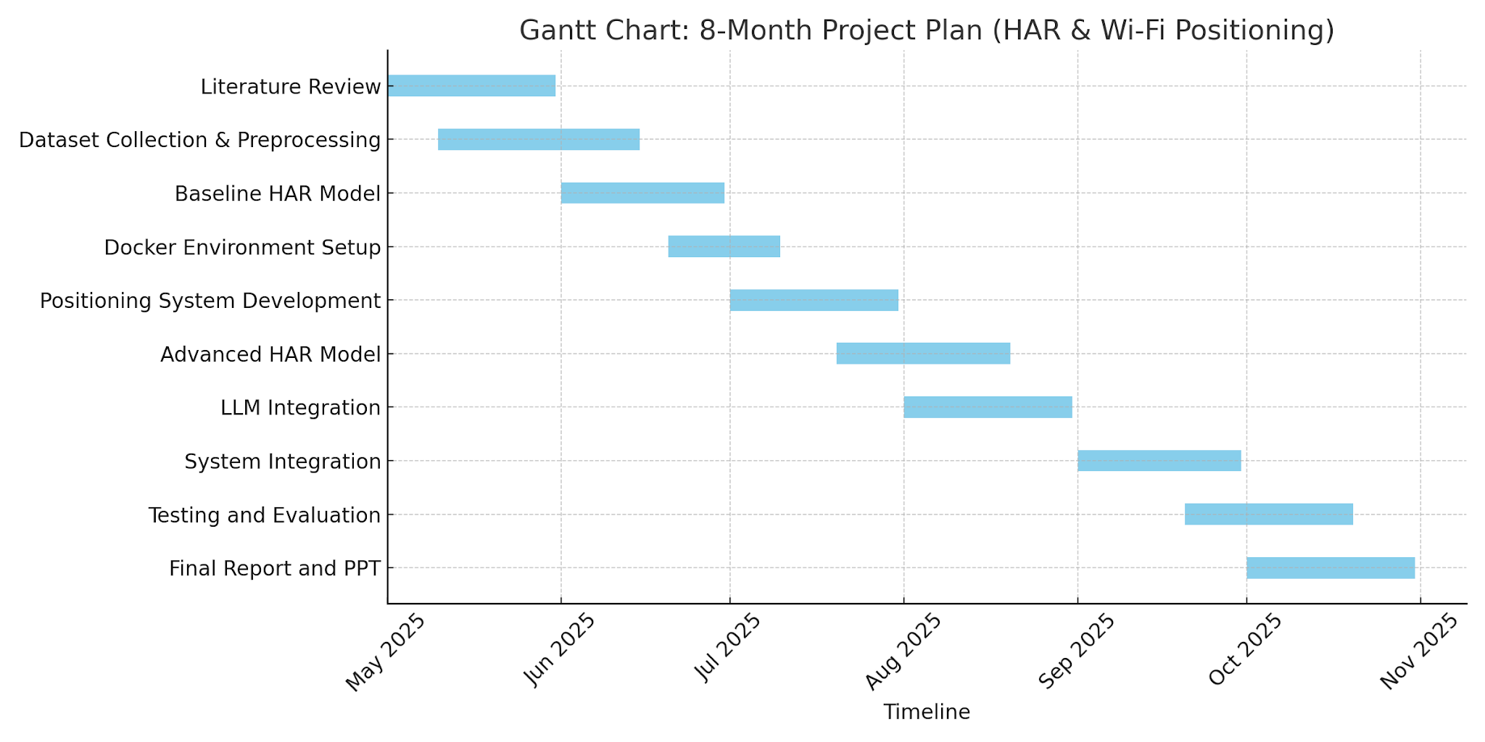

Slide 22

Basic Model Training and Experiment Stats

Slide 23
CSI Dataset Model Training Experiment
Experiment# | Dataset Range | Total Data Volume | Learning Rate | Batch Size | Folds | Epochs per Fold | Minutes/Epoch | Training Status | Loss | Accuracy
1 | 10 | 3682010 (3.68 M) | 0.0003 | 64 | 2 | 20 | 23 | Completed | 0.1946 | 0.9229
2 | 10 | 3682010 (3.68 M) | 0.0024 | 512 | 2 | 1 | 17 | Completed | 1.0953 | 0.8251
3 | 30 | 10978318 (10.97 M) | 0.0024 | 512 | 5 | 30 | 47 | Terminated | 0.6937 | 0.7110
4 | 30 | 10978318 (10.97 M) | 0.0048 | 1024 | 2 | 10 | 41 | Completed | 0.4256 | 0.8260
5 | 15 | 3682010 (3.68 M) | 0.0005 | 64 | 2 | 20 | 35 | Completed | 0.2194 | 0.9126

Slide 24
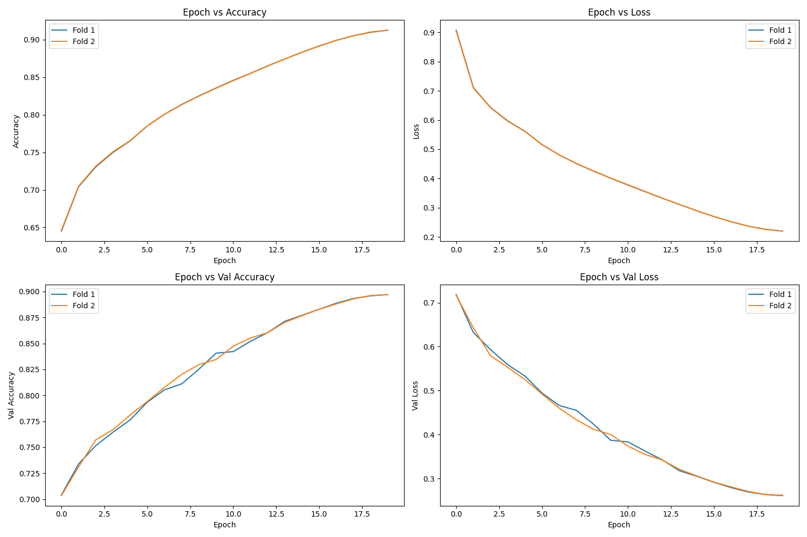

Slide 25

Expected Outcomes
Comprehensive HAR Dataset:
Curated and preprocessed Wi-Fi CSI data covering 10 activities for robust model training and evaluation.
01
Baseline & Advanced HAR Models:
Implementation of both baseline and hybrid deep learning models (ResNet-1D + BiLSTM + Attention) for activity recognition.
02
High Activity Recognition Accuracy:
03
Achieve strong classification metrics (accuracy, F1-score) across multiple activities and environments.
03
Integrated System Prototype:
04
End-to-end HAR and positioning system, deployable in real-world indoor scenarios.
Extensive Evaluation & Visualization:
The project will deliver a validated, privacy-preserving HAR solution with reproducible results and practical deployment potential.
04
Detailed performance analysis, confusion matrices, and class distribution insights.
Final Deliverables:
Complete technical report, project documentation, and presentation summarizing findings and system performance.

Slide 26
Scope for Future Work (Next Semester)
Deploy real-time HAR system on edge/IoT devices
Expand to multi-user and multi-room environments
Add more activity classes for finer recognition
Optimize model for faster, lightweight inference
Explore multimodal fusion with other sensors
Focus: Transition from research to practical, scalable deployment.

Slide 27
Thank You

Slide 28
MTECH AAI COHORT-1 Dissertation Project – Phase 1
Final Evaluation
Presented by: Sanjeev Kumar Pandey
Enrolment No: MT23AAI001
Project Guide: Dr. Amit Agrawal

Slide 29
Evaluation#3
03
Concluding Phase-1

Slide 30
CSI Dataset Model Training Experiment
Experiment# | Dataset Range | Total Data Volume | Learning Rate | Batch Size | Folds | Epochs per Fold | Minutes/Epoch | Training Status | Loss | Accuracy
1 | 10 | 3682010 (3.68 M) | 0.0003 | 64 | 2 | 20 | 23 | Completed | 0.1946 | 0.9229
2 | 10 | 3682010 (3.68 M) | 0.0024 | 512 | 2 | 1 | 17 | Completed | 1.0953 | 0.8251
3 | 30 | 10978318 (10.97 M) | 0.0024 | 512 | 5 | 30 | 47 | Terminated | 0.6937 | 0.7110
4 | 30 | 10978318 (10.97 M) | 0.0048 | 1024 | 2 | 10 | 41 | Completed | 0.4256 | 0.8260
5 | 15 | 3682010 (3.68 M) | 0.0005 | 64 | 2 | 20 | 35 | Completed | 0.2194 | 0.9126

Slide 31
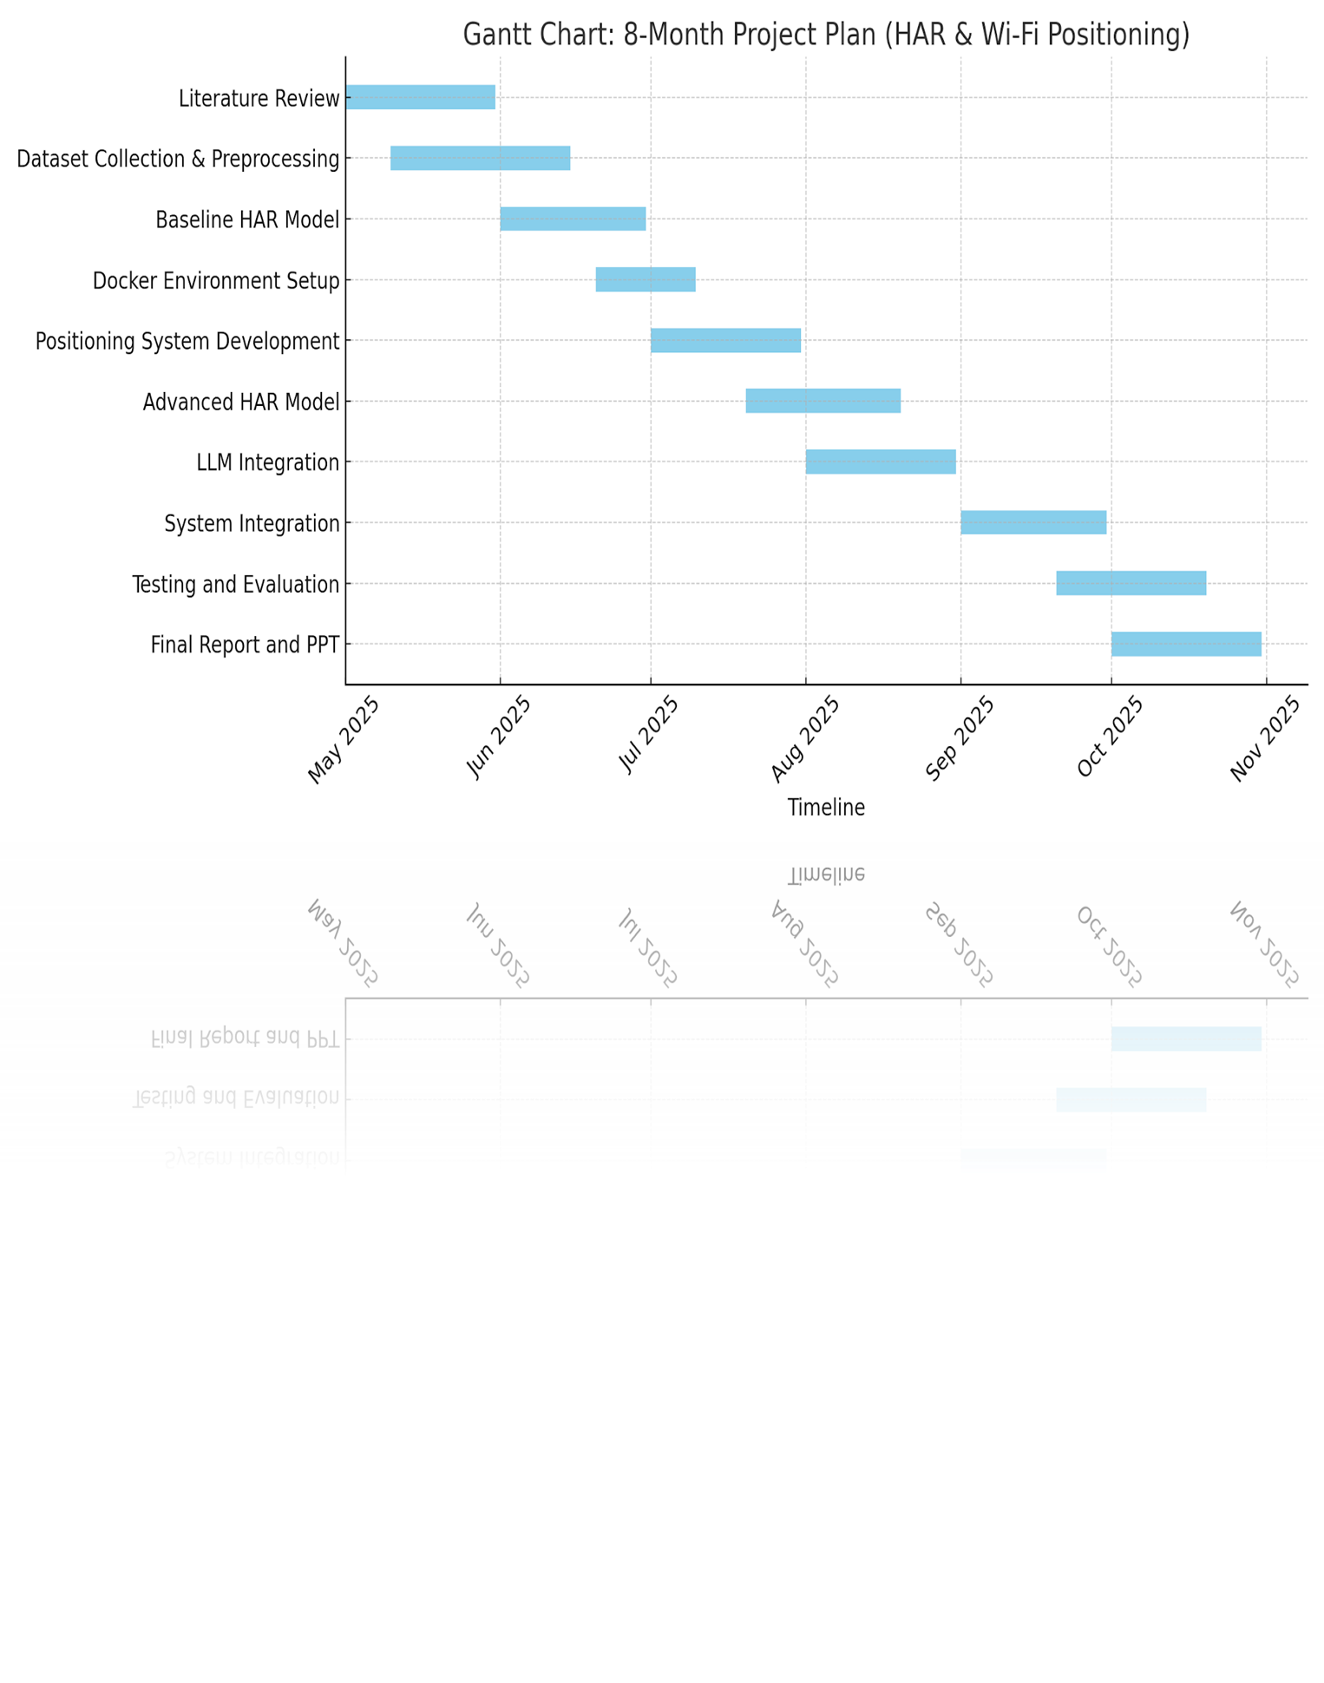

Slide 32
CSI Dataset Model Training Experiment
Experiment# | Dataset Range | Total Data Volume | Learning Rate | Batch Size | Folds | Epochs per Fold | Minutes/Epoch | Training Status | Loss | Accuracy
1 | 30 | 10978318 (10.97 M) | 0.0005 | 64 | 4 | 20 | 60 | Ongoing - 1 Fold Completed | 0.2467 | 0.9003
Hardware used
Apple M4 Pro
Memory 24 GB

Slide 33
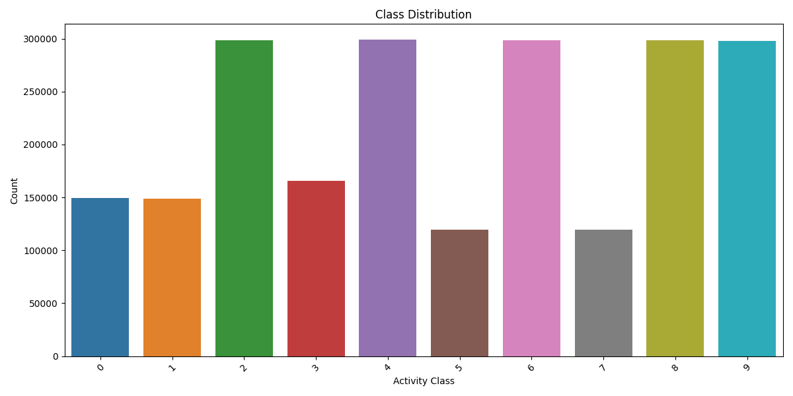

Slide 34
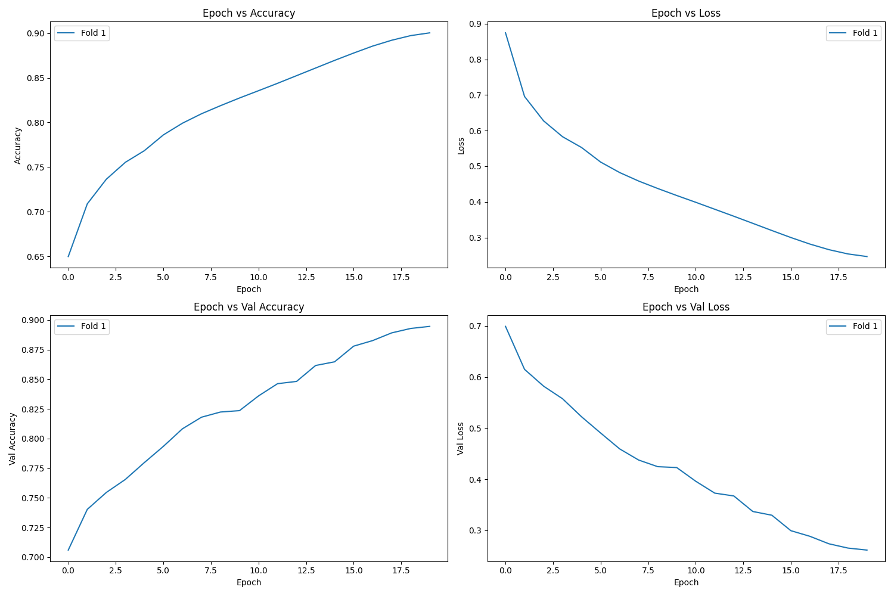

Slide 35
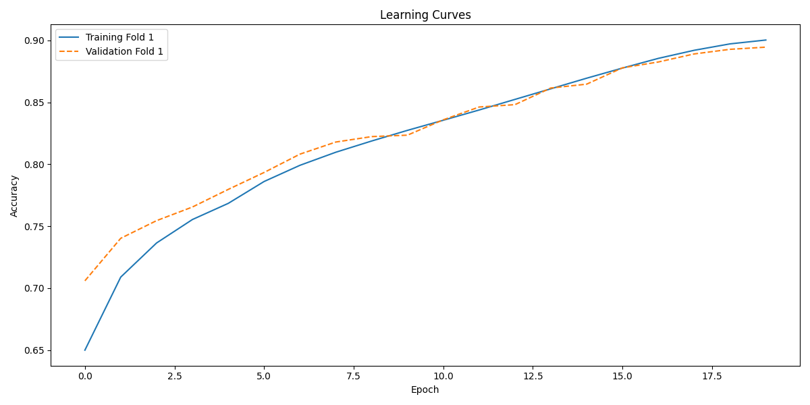

Slide 36
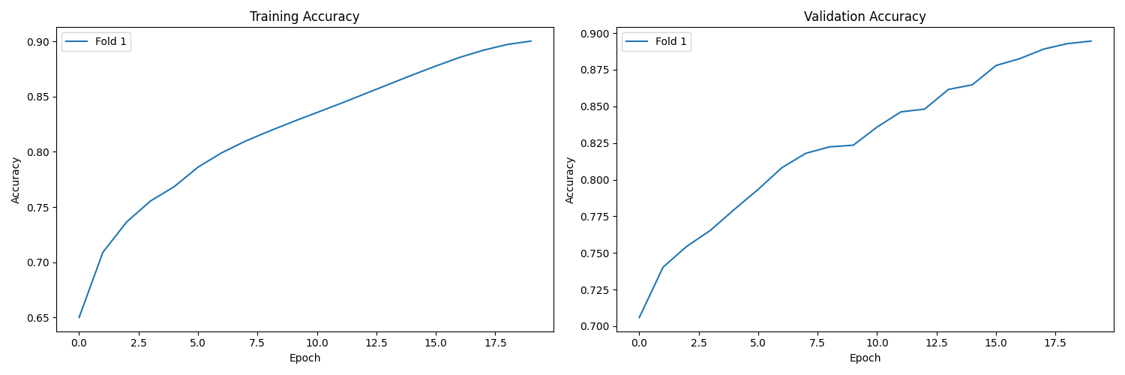

Slide 37

Dockerized the application and running on port 5001

Slide 38
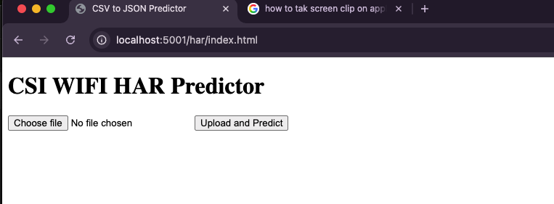
http://localhost:5001/har/index.html

Slide 39
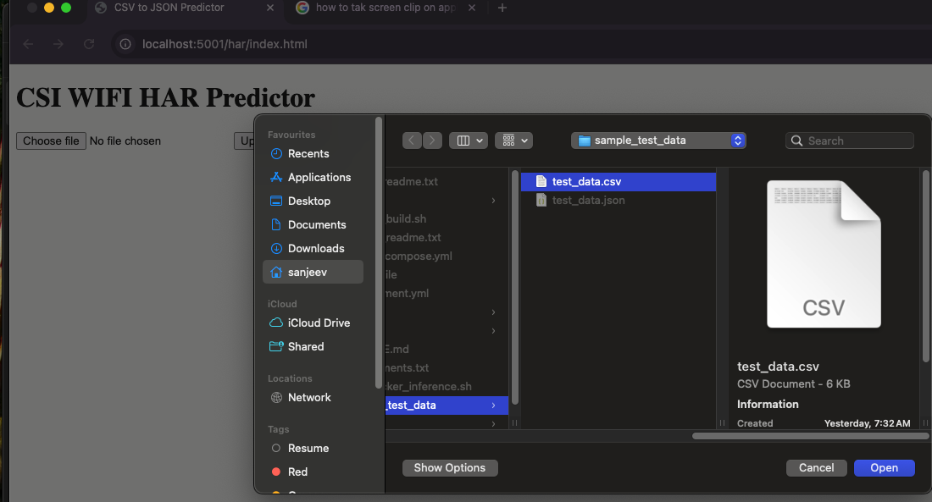

Slide 40
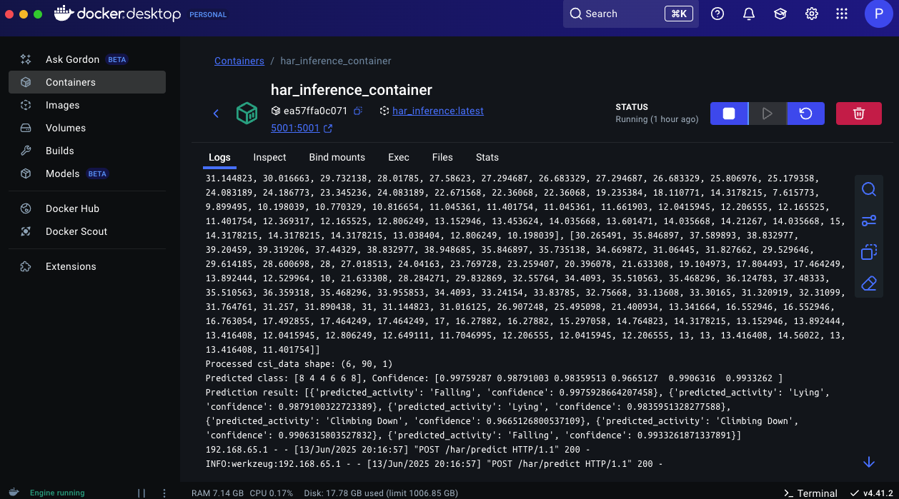

Slide 41
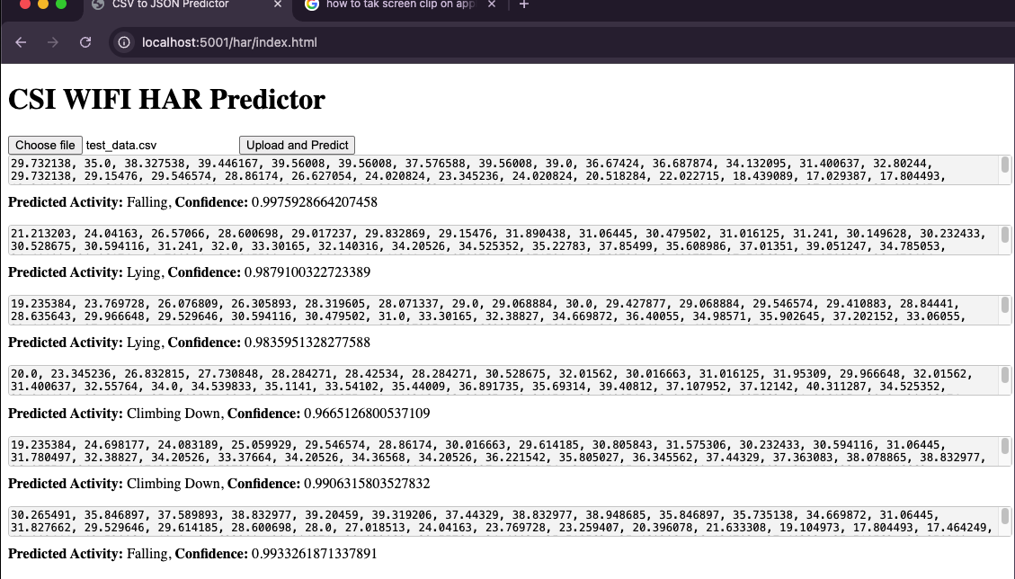

Slide 42
Thank You

Slide 43
https://pmc.ncbi.nlm.nih.gov/articles/PMC7704290/ https://data.mendeley.com/datasets/v38wjmz6f6/1

Slide 44
MTECH AAI COHORT-1 Dissertation Project – Phase II
Evaluation-I
Presented by: Sanjeev Kumar Pandey
Enrolment No: MT23AAI001
Project Guide: Dr. Amit Agrawal

Slide 45
Human ID & Activity Prediction using Wi-Fi Signals
Leveraging Wi-Fi Channel State Information (CSI) and RSSI
Sanjeev Kumar Pandey | 10-Sep-2025

Slide 46
Project Objectives
Dataset Aim: Wi-Fi-based Human Activity Recognition (HAR) in indoor environments (LOS & NLOS).
Objective 1: Detect the activity action type from Wi-Fi signals.
Objective 2: Detect the ID of the person performing the activity.

Slide 47
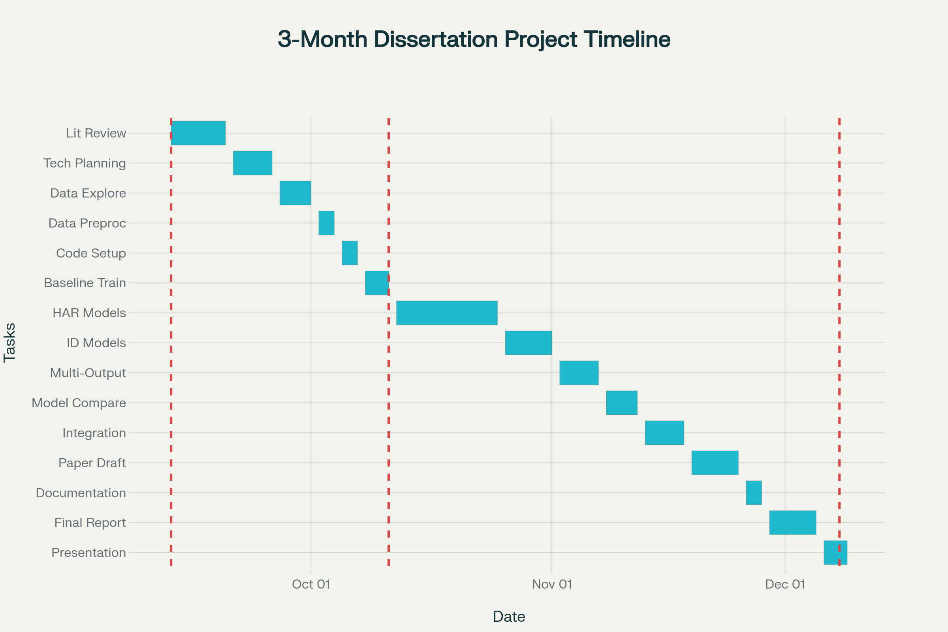

Slide 48
Planning overview
Literature Review & Planning: Start with reading key papers, setting objectives, and technical planning.
Data Understanding & Preprocessing: Explore dataset, feature extraction, and handle CSI/RSSI preprocessing.
Initial Coding & Baseline Model (Eval 1): Set up coding, implement baseline models, run initial training and evaluation.
Advanced Model Training & Experimentation (Eval 2): Design and train advanced models (HAR, Human ID, multi-output), experiment, and tune.
Analysis & Integration: Compare results, integrate best-performing models, and conduct error analysis.
Research Paper Drafting & Documentation: Start documentation and research paper draft, plus slides for presentation.
Final Report & Presentation (Eval 3): Polish final report, prepare for oral defense, and respond to committee feedback.

Slide 49
Dataset Overview
Source Paper: 'A dataset for Wi-Fi-based human activity recognition in LOS and NLOS indoor environments'. https://pmc.ncbi.nlm.nih.gov/articles/PMC7704290/pdf/main.pdf
Authors: Baha’ A Alsaify et al., Jordan University of Science and Technology, German Jordanian University.
Publication Date: November 18, 2020.
Purpose: Benchmark dataset for HAR research across LOS & NLOS settings.

Slide 50
Key Features of Dataset
Participants: 30 subjects (28 male, 2 female), age ~22.7 ± 2.95 years.
Activities: 12 unique actions across 5 experiment classes.
Environments: 2 LOS (lab, hallway) + 1 NLOS (wooden wall barrier).
Data Types: Channel State Information (CSI) and RSSI values.
File Naming: Ex_Sy_Cz_Ai_Tk.csv (e.g., E1_S04_C3_A7_T17.csv).

Slide 51
Feasibility of Human ID Prediction
Subject ID explicitly labeled in filenames (S1–S30).
Biometric info (age, weight, height) subtly affects signals.
CSI & RSSI are sensitive to individual movement signatures.
Rich dataset (3000 trials) suitable for Human ID modeling.

Slide 52
Use Case: Security & Monitoring
Traditional biometrics (faces, fingerprints) can be spoofed & require active participation.
Wi-Fi-based ID is passive, non-intrusive, and works in NLOS environments.
Applications: High-security zones (ISRO, NASA, Parliament House), covert surveillance, medical alerts.

Slide 53
Target Variables
HAR Activity Recognition: Classify 12 unique activities (A1–A12).
Human ID: Identify 1 of 30 subjects (S1–S30).
Input Data: CSI & RSSI values sensitive to presence & movement.

Slide 54
Model Development Approaches
Approach 1: Two Separate Models
  HAR Activity Classifier (12 classes).
  Human ID Classifier (30 subjects).
Approach 2: One Multi-Output Model
  Single model with shared features.
  Two output heads: Activity & ID.

Slide 55
Conclusion & Next Steps
Dataset provides rich labeled Wi-Fi signal data (CSI, RSSI).
Suitable for both HAR and Human ID tasks.
Choice: Separate models (simplicity) vs. Multi-output model (efficiency).
Next Step: Implement and evaluate both approaches.

